Slide 1
IP exam scores 2025 - Score Distribution

Slide 2
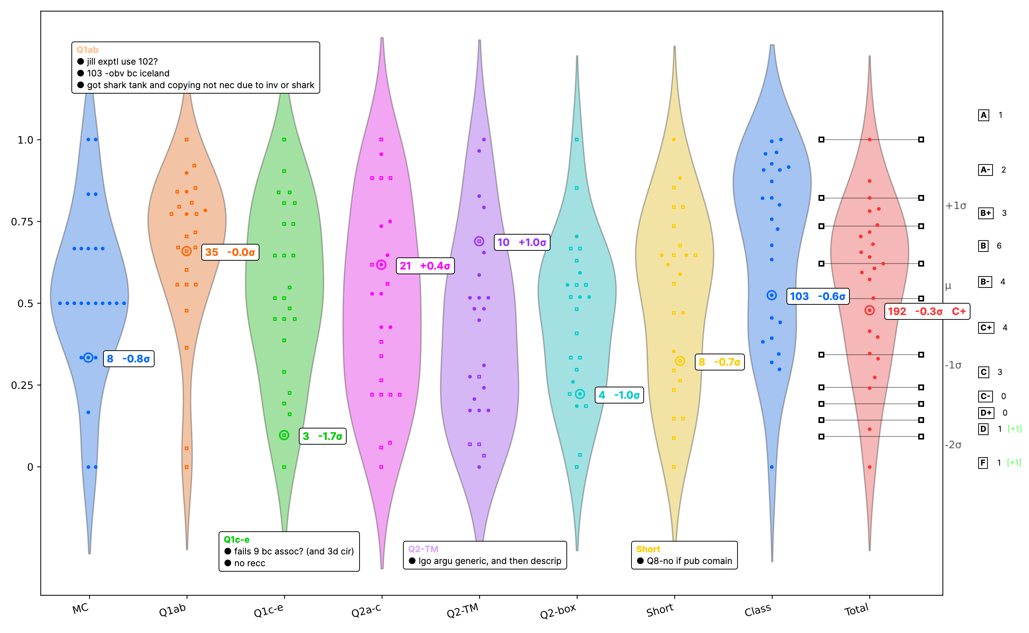
IP exam scores 2025 - Component Analysis

Slide 3
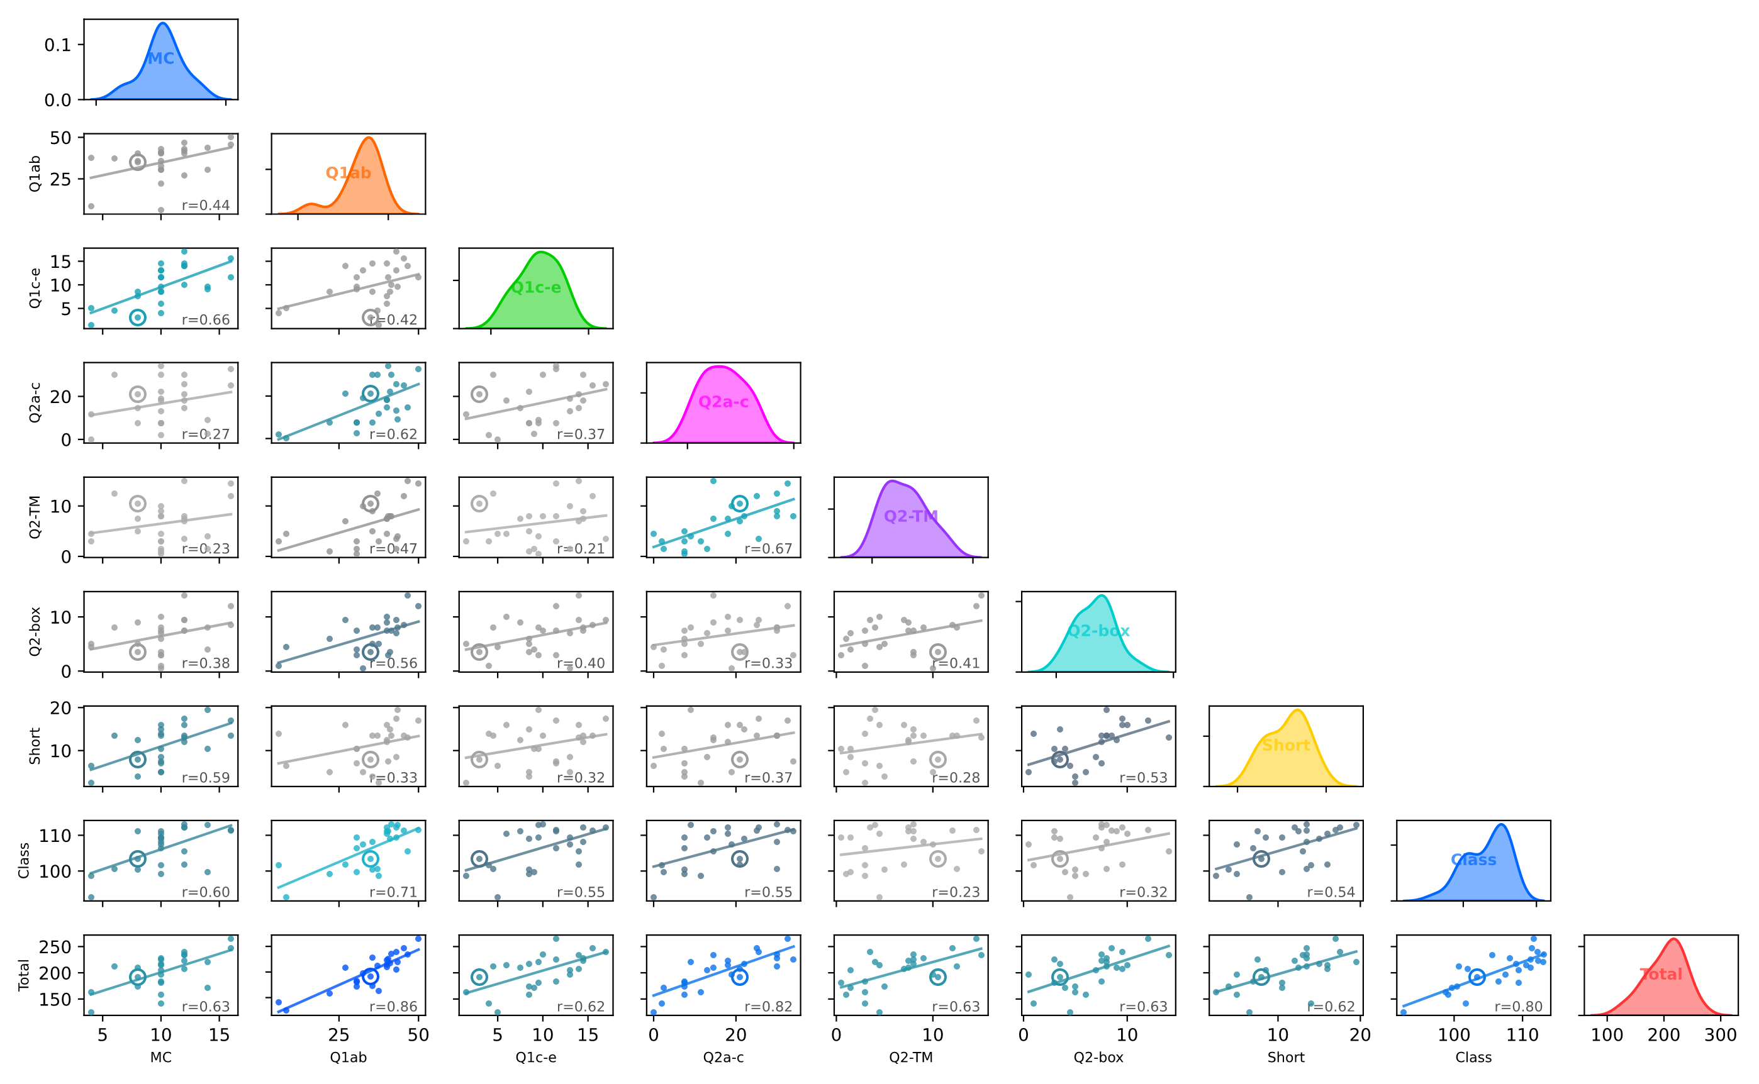
IP exam scores 2025 - Score Correlations

Slide 4
IP exam scores 2025 - Grade Breakdown
Grade | Count | Target | Percentage | Delta
A | 1 | 1-2 | 4.0% | -
A- | 2 | 1-4 | 8.0% | -
B+ | 3 | 2-5 | 12.0% | -
B | 6 | 5-8 | 24.0% | -
B- | 4 | 2-6 | 16.0% | -
C+ | 4 | 2-6 | 16.0% | -
C | 3 | 1-5 | 12.0% | -
C- | 0 | 0-0 | 0.0% | -
D+ | 0 | 0-0 | 0.0% | -
D | 1 | 0-0 | 4.0% | +1
F | 1 | 0-0 | 4.0% | +1
Total | 25 | - | 100% | -

